Slide 1


Fáilte go
Gaelscoil na mBeann
Rang 1
Múinteoir – Laura McCann
Cúntóir - Sally Clarke
Dé Máirt 26ú Deireadh Fómhair 2021
Tuesday 26th October 2021

Slide 2
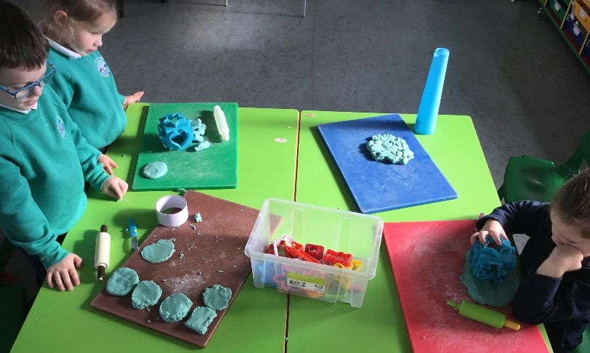
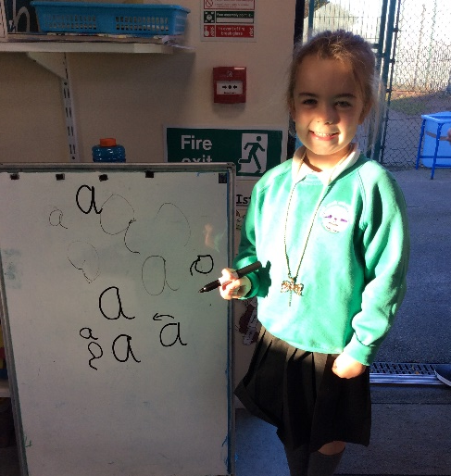
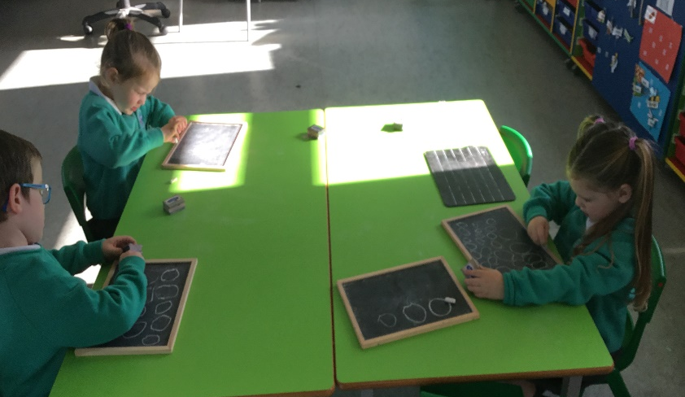
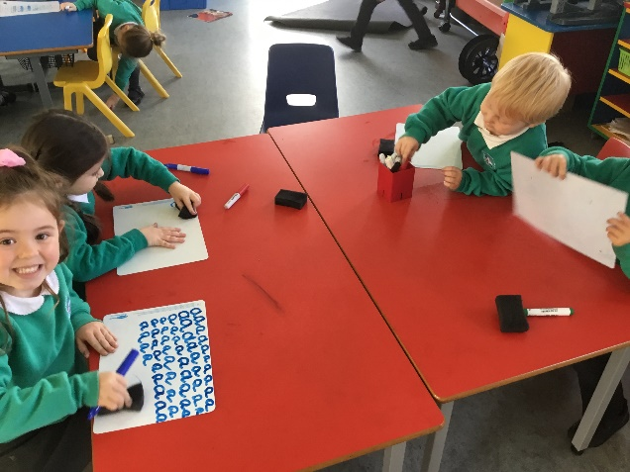
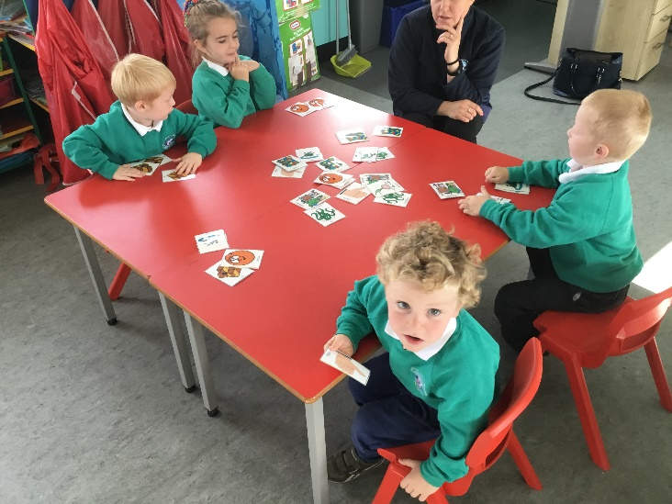
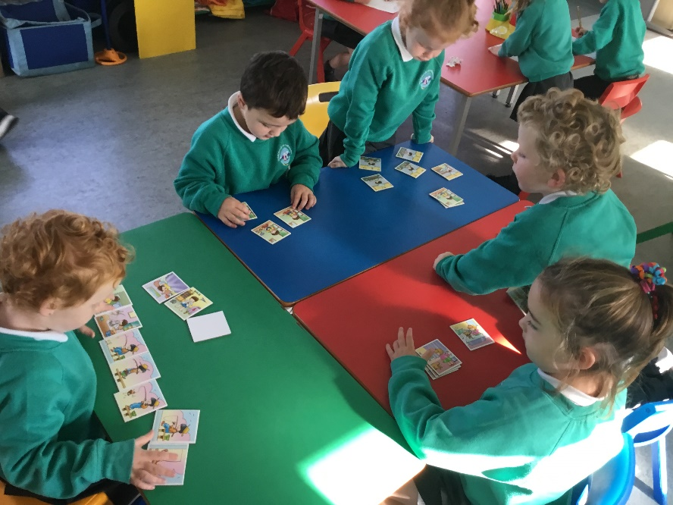
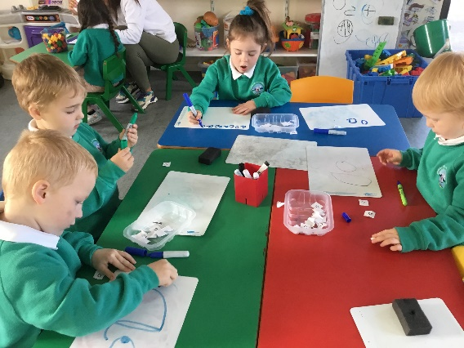
Litearthacht

Slide 3
Litearthacht
In Rang 1 we teach the same language concepts and literacy skills as is taught in any other Primary 1 classroom:
Talking & Listening
Phonological Awareness
Writing
Reading
In literacy we teach:
Attention and listening development
Rhyme, syllables and beginning sounds
Phonics, sound, blending
Keywords to learn at home to help pupils with emergent reading
Reading skills e.g. turning pages, reading from left to right, and using pictorial clues to help tell the story
Writing skills, starting off with individual letters/sounds, building up to words, and progressing to sentence level towards the end of the year.

Slide 4
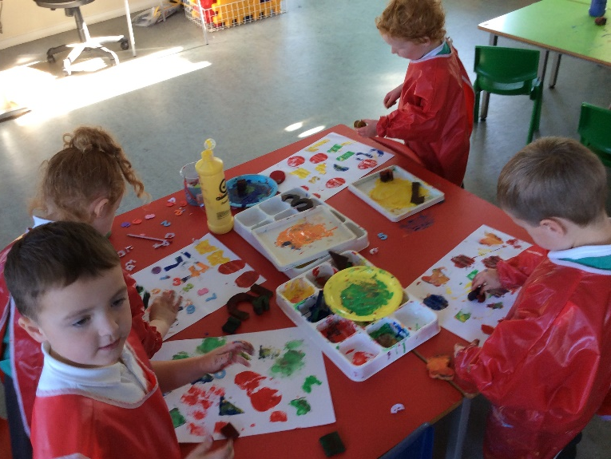
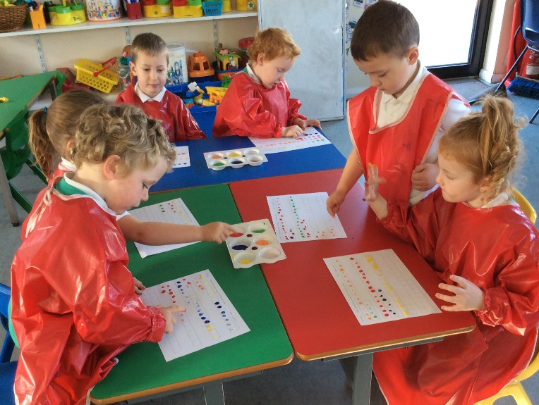
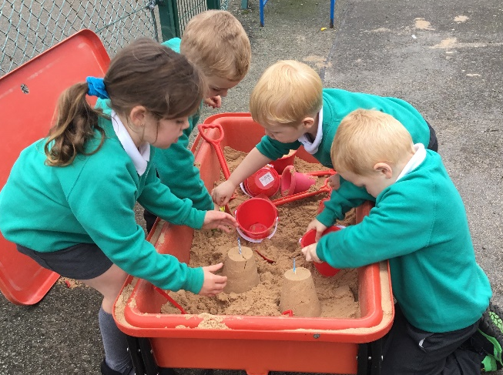
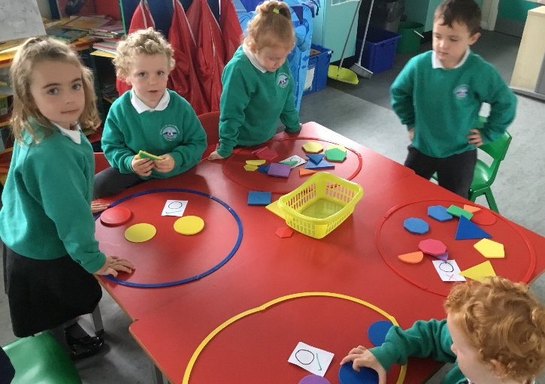
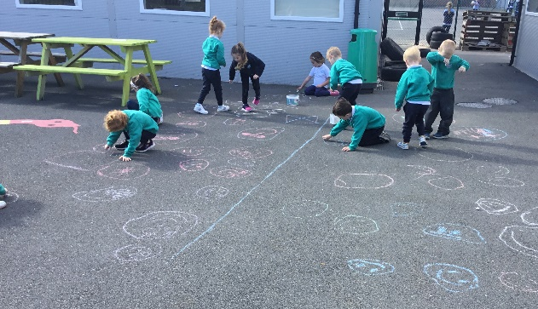
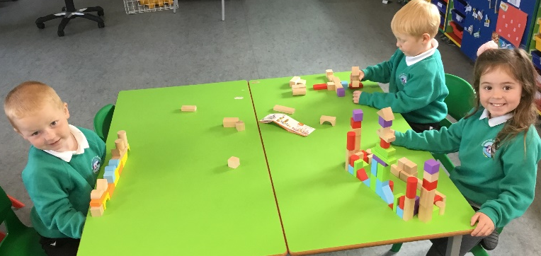
Uimhearthacht

Slide 5
Uimhearthacht
Children are introduced to mathematical concepts through activities that involve sorting, matching, comparing, classifying, and making patterns and sequences in a variety of contexts. These activities involve children in playing, exploring and investigating, doing and observing, talking and listening, and asking and answering questions.
Throughout their year in Rang 1, the children will be enabled to develop their awareness and understanding of the following areas of Mathematics and Numeracy through practical activities and games:
NUMBER: Understanding Number / Counting and Number Recognition / Addition / Subtraction / Understanding Money
MEASURES: Length / Weight / Capacity / Volume / Area / Time
SHAPE AND SPACE: 2- D Shape / 3D Shape
POSITION, MOVEMENT AND DIRECTION
SORTING
PATTERNS AND RELATIONSHIPS

Slide 6
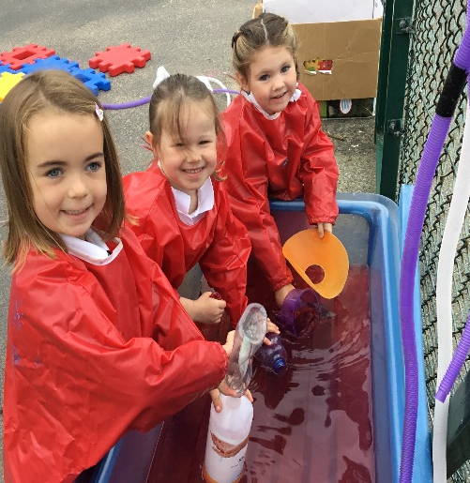
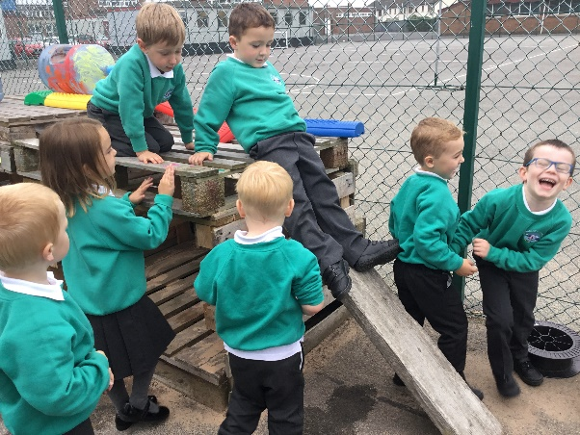
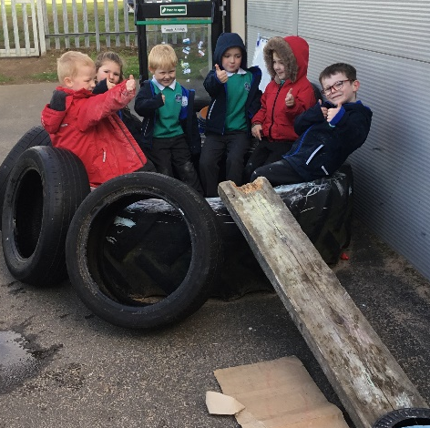
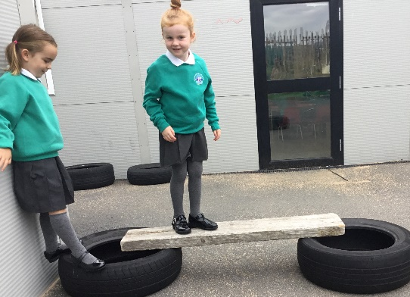
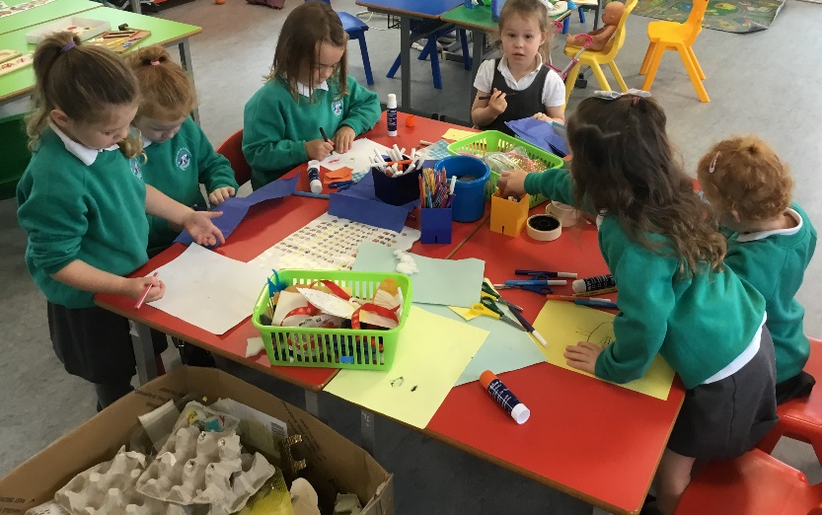
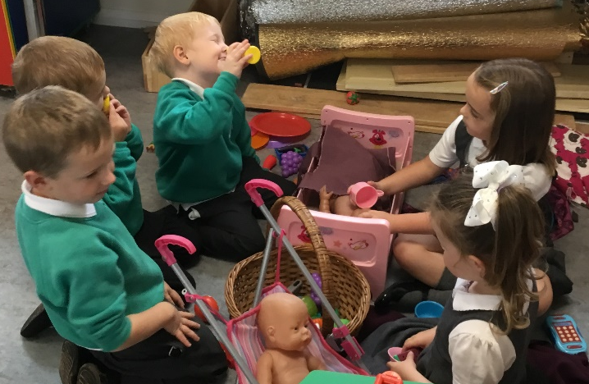
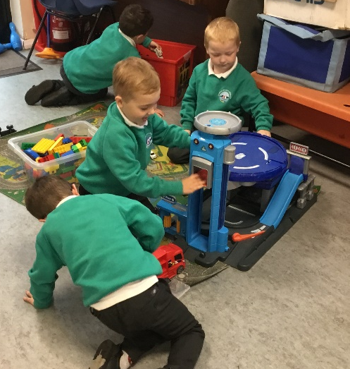
Súgradh / ADTO

Slide 7
Play & The World Around Us
A significant proportion of the curriculum in Rang 1 is delivered through play-based learning. In the foundation stage in Gaelscoil na mBeann we feel that the children are reaping the rewards from child led / free play approach which inside and outside play are intertwined.
Children learn to problem solve, take turns, share, explain their methods and extend their vocabulary and communication skills through language rich, adult supervised/modelled play experiences.
This year we will cover these topics through The World Around Us:
Mo chlann agus an Fómhar – My family & Autumn
Daoine a chuidíonn linn agus an Nollaig – People who help us & the Christmas season
Solas agus Dorchadas & An Gheimhreadh – Light and Darkness & Winter
An tEarrach agus Bia – The Spring & Food
An Samhradh & Sárlaochra – The Summer & Heroes

Slide 8
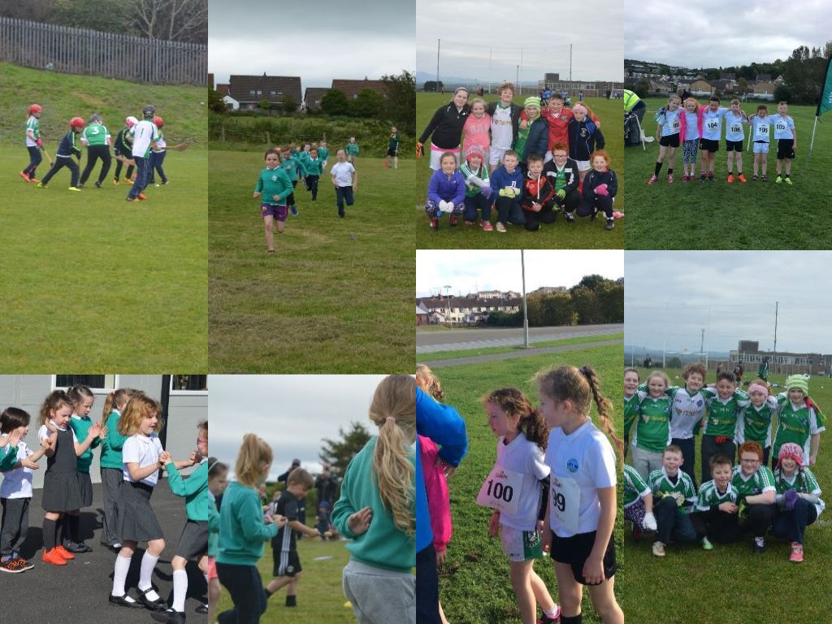
Spórt i nGaelscoil na mBeann

Slide 9
Imeachtaí Seach-churaclaim
Extra-curricular activities
Club Bricfeasta – breakfast club
Afterschool Facilities - includes homework clubs, football, music, library club, etc…
Summer Schemes - having fun and speaking Irish in July (Longstone & Gaelscoil na mBeann)
School trips, walks and outings
Choir / Christmas play / Scoil Dramaíochta
Cross country races / football tournaments & matches / swimming lessons

Slide 10
Obair Bhaile - Homework
Beginning after the Halloween break, Rang 1 will be starting homework. Each week there will be Literacy, Numeracy and World Around Us to complete.
The literacy tasks will be set on a Tuesday and Thursday to match up with the Homework Club.
Spellings and word games each night
Reading – reading with your child is vitally important and when your child is ready to read independently, reading books will be sent home.

Slide 11
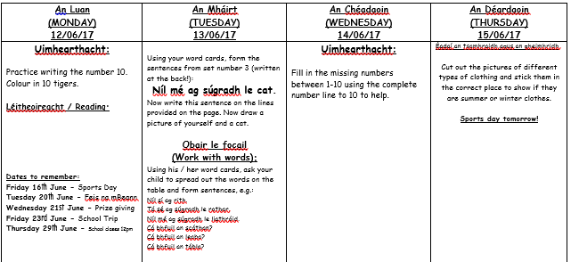
Obair Bhaile - Homework
Below is an example of how the weekly homework plan looks:
What to complete and how to complete instructions for parents
Irish language for parent
Learning homework
Reading homework

Slide 12
Ag foghlaim sa bhaile /
Learning at home
Litearthacht sa bhaile / Literacy at home:
Focail le foghlaim / words to learn: cards will be sent home with key words to learn. Parents can provide many opportunities to play games e.g. snap / pairs / old maid.
You can extend this practice by writing their words on “postits” and placing them around the house e.g. in the bath / on the fridge / the TV. The more exposure, discussion and practice they have of their key words, the better.
Fuaimeanna / sounds to learn and recognise in their home environment e.g. “ There’s a ‘C’ in ‘Cornflakes’”.
Léitheoireacht / daily reading with your child is vitally important. Reading books will be sent home when your child is ready to read independently. However, strategies can be practised every night: e.g.
observing the front cover, what is the story about? Who is the author? Who illustrated the book?
turning the pages independently
Using the pictures to help understand what is happening
Using their “magic finger” under the words to see where the writing is and recognise any sounds / words they know
Our Paired Reading scheme is a great way for you to read with your child.
Scríbhneoireacht: Try to encourage your child to write at home for fun. E.g.;
-Birthday cards are a great way of getting them to practice their name.
- Writing outside: a bucket of water and a paint brush / chalk on the ground / in the sandpit or mud
-Drawing pictures and writing words to describe their pictures
-positive encouragement when your child attempts to write their sounds / words from school

Slide 13
Ag foghlaim sa bhaile /
Learning at home
Uimhearthacht / Numeracy at home: for your child to recognise that numeracy isn’t “just a thing that happens in school” is extremely beneficial for your their number and maths understanding.
E.g:
Counting the cars parked outside / counting steps & stairs / counting games inside & outside e.g. board games, snakes and ladders, counting how many swings there are in the park, Setting the table – cutlery, cups etc
Recognising, naming and investigating shape (2d and 3d) in the world around them e.g. “The kitchen table is a circle.” “The door is a rectangle.” “The box is a cube.” “That pot is a cuboid.” Bingo – shapes
Number rhymes & songs
Spotting different numbers in the environment – door numbers, car number plates
Out shopping – know that we need money to buy things, start to recognise coins 1p, 2p, 5p, 10p
Awareness of time & days of the week – time they get up, eat breakfast, leave for school, eat dinner, go to gymnastics, go to football (simple visuals and continued practice & discussion help)
Cooking – weighing ingredients, reading scales, adapting recipes.
Keeping score in games – knowing that they won’t always win is very important.

Slide 14
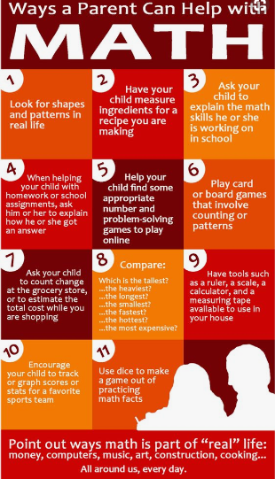

Slide 15
Ag foghlaim sa bhaile /
Learning at home
These key home learning points are only a fraction of what can be done at home to support your child’s learning.
Please don’t be afraid that if you practice numeracy and literacy skills with them in English that they will get confused – they won’t. The learning concepts are the same in all languages. Our Gaelscoil children are masters of their bilingual practice from the get-go. The fact they will be learning things in two languages (or more) is their “superpower”!
However, all Irish phrases for home learning will be sent home / via seesaw and we will always oblige our parents if they seek to learn a word / phrase. They will LOVE to hear you learn these (and enjoy correcting you too!) and this will help provide a better an even better context for their immersion education.
In Gaelscoil na mBeann we recognise that the learning begins at home. We are willing to support and help our parents in any way we can.

Slide 16
Ag cuidiú le do pháiste
Supporting your child
There are some fantastic websites to assist parents with Irish and support their child, such as:
http://www.abair.tcd.ie/ - enter a word as Gaeilge, this site will dictate it (choose Gaoth Dobhair)
http://www.timestables.me.uk/printable-pdf-quiz-generator.htm
http://ccea.org.uk/curriculum/gaeloideachas/eochairchéimeanna_1_2/réims%C3%AD_foghlama/matamaitic_agus_uimhearthacht/clog Learning the clock as Gaeilge
www.bbc.co.uk/northernireland/irish/blas
www.irishforparents.ie
and many more!

Slide 17
Ag ullmhú do Rang 1
It is important to encourage your child’s independence and self care by;
Putting on own shoes, jumper, coat
Velcro shoes
All clothes labelled
How to use lunchboxes, Tupperware, open a banana etc…
Colouring in & scissor skills
Recognise own name

Slide 18
Iompar na scoile
Behaviour & Discipline
School Discipline
The classroom, school and playground rules are intended as a means of ensuring order and safety and an environment in which learning can take place. In Gaelscoil na mBeann, all pupils are expected to behave in a responsible manner both to themselves and others, showing consideration, courtesy and respect for others at all times.
We encourage positive behaviour using rewards systems in line with our school behaviour policy for example:
-“Kind hands, kind feet, kind words.”
-Traffic light system
-“Golden Time” gain your reward system
-Classroom rewards – stars / tickets / stones in the pot

Slide 19
Communication with
Parents via “Seesaw”
For Students
Seesaw empowers students to independently document their learning with built-in creative tools, and provides an authentic audience for their work.
For Families
Seesaw gives families an immediate and personalized window into their child’s school day, and makes communication with teachers seamless.
For Teachers
Seesaw saves time on organization and parent communication, makes formative assessment easy, and provides a safe place to teach 21st Century skills.
Lead by the teacher
Used to celebrate success
Used for observations and to monitor progress
To improve link with parents

Slide 20
What you will see on Seesaw?
Photo
Drawing
Text
Class Note or Announcement
Voice Recording
Handwriting
Video

Slide 21
Ceisteanna ar bith?
Any questions?
Please contact Múinteoir Laura with any questions you have regarding your child’s education in Rang 1.
Go raibh maith agaibh!

